Slide 1
PROJECT name: ANY TIME MOVIE TICKET (ATMT)
JAVA PROJECT
Guided by Ms. AVANI PATEL MAM
MEMBER NAME
ENROLLMENT NUMBER:- 216400307127
NAME:- SOLANKI TRUSHEN
ENROLLMENT NUMBER:- 216400307128
NAME:- PRAJAPATI RUDRA
ENROLLMENT NUMBER:- 216400307129
NAME:- PITRODA RUDRA
ENROLLMENT NUMBER:- 216400307133
NAME:- PATEL VEDANT

Slide 2
Project introduction
This Project Is About Movie Ticket Counter
It Is Easily To Any User To Print Their Ticket In This Project First We Find The User Age If User Are Less Than 18 Year They Not Able To Buy Online Ticket If User 18 + They Are Able To Buy Online Ticket.
In Second Scenario User Can Choose Their Choice Of Movie
Third And Last Scenario How Many Ticket User Are Want To Print This Is First Phase Of The This Project

Slide 3
second phase of this project
The Second Phase About Selections.
In The Second Phase User Can Select Seats In Silver/Gold/Diamond.
In Second Scenario Program Print All Details About Movies And Seat Price And Program Will Print Bill Of Movie Tickets.
In Third Scenario User Can Choose Multiple Payment Methods For Paying Bill Of Tickets
Four And Last Scenario Print All Movie Tickets.

Slide 4
project scope
There Are Five Scope Of This System
1.Age Checker
2.Choose Movies
3.Seat Selection
4.Ticket Quantity
5.Print Tickets

Slide 5
Project algorithm
Step 1 − START.
Step 2- Declare Ten Integers I, Age, A, Count, Total, Capacity, P, Select, F, S
Step 3- Declare Two Character Variable Name, Movie
Step 4- Print A Message Welcome To The PVR Cinema.
Step 5- Print Ask To User What Is Your Name.
Step 6- Print Ask To User What Is His/Hers Age.
Step 7- If(age<=18) Then
Output The List Of Movies You Can Watch .
Print Selected Movie Name And Details.
Print Select Your Seats In Silver/Gold/Diamond
Print How Many Tickets You Want.
Print Selected Seat Price And Total Amount
Print All Tickets
Else
Print You Are Not Able To Buy Tickets
Step 8- Stop

Slide 6
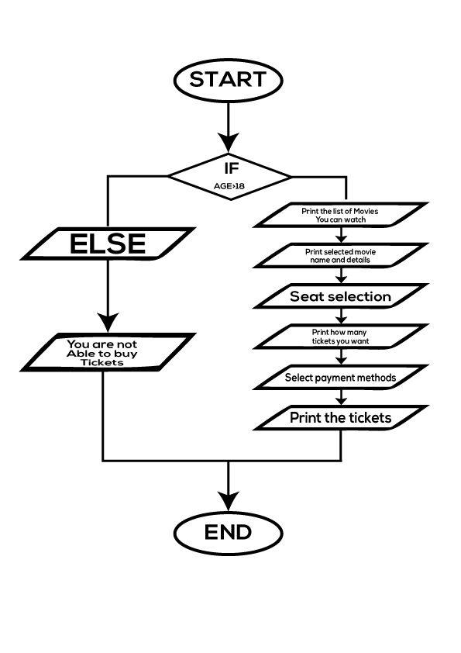
flowchart

Slide 7
logic of this PROJECT
This Message Was Print Welcome To The ATMT
User Enter His/Hers Name
User Enter His/Hers Age
If User Age Is Greater-than 18 Then Print Movies List
User Select Movie And Then Print Movie Name And Details
Then User Select Seats In Silver/Gold/Diamond
Then Ask For User To How Many Tickets His/Hers Wants
Print Total Bill And Print The Movie Tickets
If User Age Is A Less -Than 18 Then User Not Able To Buy Tickets
End Of This Programme

Slide 8
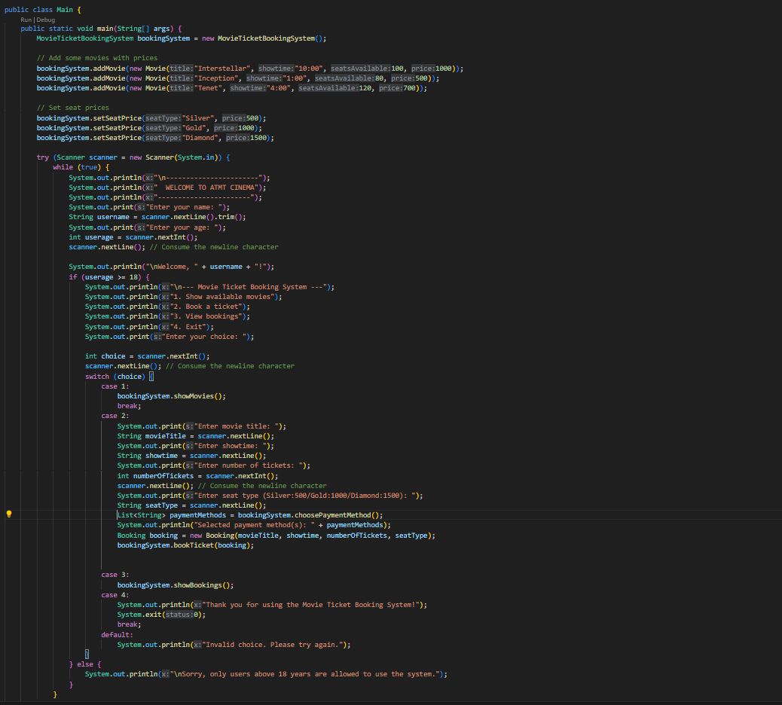
CODE SCREESHOT

Slide 9
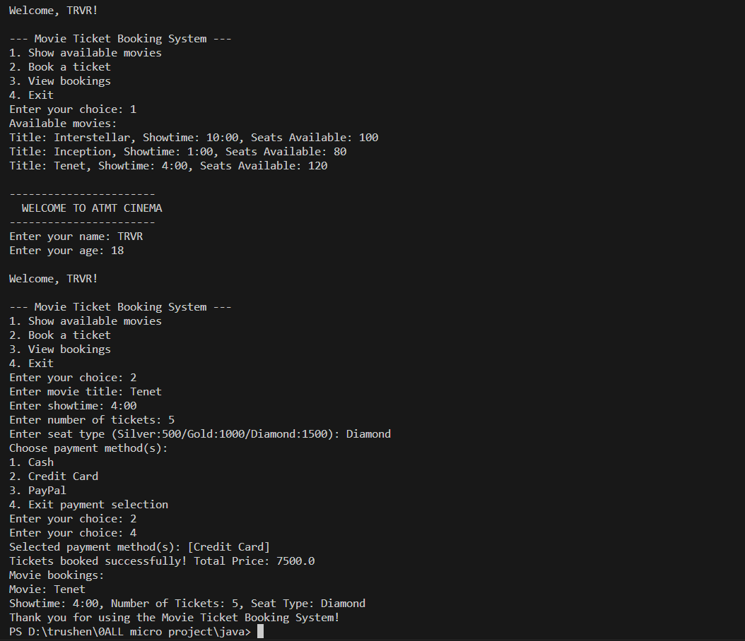
OUTPUT SCREENSHOT

